Slide 1
Обновление каталога 29.11.2021

Slide 2
1.Обновление принципа систематизации методов (концепция пяти параметров, присваиваемых методу) 2. Сокращение каталога до двух основных веток, на основе которых будет происходить тестирование 3.Сокращение каталога до 14 методик на основе которых будет тестироваться принцип систематизации методов, структура каталога и работа поиска
Задачи

Slide 3
КОНЦЕПЦИЯ 5-И ПАРАМЕТРОВ МЕТОДА
Name
УНИКАЛЬНО
+ алиасы
Alternative name
Object
МОЖЕТ БЫТЬ
НЕСКОЛЬКО
Sub-Object
Application
МОЖЕТ БЫТЬ
НЕСКОЛЬКО
Sub-Application
Type
МОЖЕТ БЫТЬ
НЕСКОЛЬКО
Sub-Type
*Имеет теоретическое
описание
Group
Tag
НА РАЗВИТИЕ

Slide 4
КАТАЛОГ ИЗ 2Х ВЕТОК
на развитие…
АДРЕСНАЯ КНИГА ИНО КЛАССИФИКАЦИИ
С ПОЯСНЕНИЯМИ
ГОЛАЯ АДРЕСНАЯ КНИГА
Method groped by object
and application
Method groped by type of technic
Human
Animal
Plants
Microorganisms
Tissue
Organ
Cell culture
Cell
Organelle
Biological Molecules
Physical and Physicochemical methods
Chromatography and similar technics
Electrophoretic methods
Proteins and peptides
Nucleic acids
Lipids
Carbohydrates
Small molecules
Amino acids
APL

Slide 5
со-зависимые
 |  | Catalog (Object-Application) |  |  |  | Textbook (Type of technique) |  |  | Tags
N | Method name | Object (уровень 2) | Sub-Object (уровень 3) | Application (уровень 3) | Sub-Application (уровень 4) | Type (уровень 1) | Sub-Type (уровень 2) | Group (уровень 3) | Topic
1 | SDS-PAGE | Biological Molecules | Proteins and peptides | Analysis | Qualitative | Physical and Physicochemical methods | Chromatography and similar technics | Electrophoretic methods | Biochemistry, Biotechnology, Molecular biology
2 | Native PAGE | Biological Molecules | Proteins and peptides | Analysis | Qualitative | Physical and Physicochemical methods | Chromatography and similar technics | Electrophoretic methods | Biochemistry, Biotechnology, Molecular biology
3 | Isoelectric focusing | Biological Molecules | Proteins and peptides | Analysis | Qualitative | Physical and Physicochemical methods | Chromatography and similar technics | Electrophoretic methods | Biochemistry, Biotechnology, Molecular biology
4 | 2D-PAGE | Biological Molecules | Proteins and peptides | Analysis | Qualitative | Physical and Physicochemical methods | Chromatography and similar technics | Electrophoretic methods | Biochemistry, Biotechnology, Molecular biology
5 | Gel electrophoresis of nucleic acids | Biological Molecules | Nucleic acids | Analysis | Qualitative | Physical and Physicochemical methods | Chromatography and similar technics | Electrophoretic methods | Molecular genetics, Biotechnology
6 | Capillary electrophoresis | Biological Molecules | Proteins and peptides | Analysis | Qualitative | Physical and Physicochemical methods | Chromatography and similar technics | Electrophoretic methods | Biochemistry, Biotechnology, Molecular biology
7 | Western blotting | Biological Molecules | Proteins and peptides | Analysis | Qualitative+Quantitative/Semi-Quantitative+Protein modifications | Blotting techniques | - | - | Biochemistry, Biotechnology, Molecular biology
 |  |  |  |  |  | Immunochemical methods | - | -
8 | Far-Western blotting | Biological Molecules | Proteins and peptides | Analysis | Protein-protein interactions | Blotting techniques | - | - | Biochemistry, Biotechnology, Molecular biology
 |  |  |  |  |  | Immunochemical methods
9 | Dot Blotting | Biological Molecules | Proteins and peptides | Analysis | Qualitative | Blotting techniques | - | - | Biochemistry, Biotechnology, Molecular biology
 |  |  |  |  |  | Immunochemical methods | - | -
10 | Flow cytometry | Biological Molecules | Proteins and peptides | Analysis | Qualitative | Immunochemical methods | - | - | Biochemistry, Biotechnology, Molecular biology, Cytology
 |  |  |  |  | Quantitative
11 | ELISA | Biological Molecules | Proteins and peptides | Analysis | Qualitative | Immunochemical methods | - | - | Biochemistry, Biotechnology, Molecular biology
 |  |  |  |  | Quantitative
12 | Southern blotting | Biological Molecules | Nucleic acids | Analysis | Qualitative | Blotting techniques | - | - | Molecular genetics, Biotechnology
 |  |  |  |  | Quantitative/Semi-Quantitative
13 | Real-Time PCR | Biological Molecules | Nucleic acids | Analysis | Qualitative | PCR Techniques | - | - | Molecular genetics, Biotechnology
14 | Quantitative real time PCR | Biological Molecules | Nucleic acids | Analysis | Qualitative | PCR Techniques | - | - | Molecular genetics, Biotechnology
 |  |  |  |  | Quantitative
Лежат в учебнике в двух местах: Blotting techniques и Immunochemical methods *исключение
Методы – в каталоге по объекту и аппликейшну
Категории (Object, Sub-Object, Application, Sub-Application) – фильтры, а также ключевые слова для поиска
Методы – статьи учебника
Категории (Type, Sub-Type level 1, Sub-Type level 2) – главы учебника
Данные о категориях вносятся через форму при добавлении метода на сайт

Slide 6
СХЕМА КАТАЛОГА (классификация объект и применение)
By object and application
Object
(уровень 1)
Molecules
….
Sub-object
(уровень 2)
Nucleic acids
Proteins and peptides
….
Application
(уровень 3)
Analysis
Analysis
…..
…..
Qualitative analysis
Quantitative analysis
Semi-quantitative
Qualitative analysis
Quantitative analysis
Semi-quantitative
Protein-protein interactions analysis
Protein modifications analysis
Sub-Application
(уровень 4)
Gel electrophoresis of nucleic acids
Real-Time PCR
Southern Blotting
ELISA
Flow Cytometry
Western Blotting
Southern Blotting
Methods
Far-Western Blotting
Western Blotting
Quantitative real time PCR
Southern Blotting
Quantitative real time PCR
Native PAGE
2D-PAGE
Dot Blotting
Western Blotting
Western Blotting
ELISA
SDS-PAGE
Isoelectric focusing
Capillary electrophoresis
Flow Cytometry

Slide 7
СТРУКТУРА КАТАЛОГА
Molecules
Nucleic Acids
Analysis
Qualitative
- Object (уровень 1)
 |  | Catalog (Object-Application)
N | Methods | Object (уровень 1) | Sub-Object (уровень 2) | Application (уровень 3) | Sub-Application (уровень 4)
1 | SDS-PAGE | Molecules | Proteins and peptides | Analysis | Qualitative
2 | Native PAGE | Molecules | Proteins and peptides | Analysis | Qualitative
3 | Isoelectric focusing | Molecules | Proteins and peptides | Analysis | Qualitative
4 | 2D-PAGE | Molecules | Proteins and peptides | Analysis | Qualitative
5 | Gel electrophoresis of nucleic acids | Molecules | Nucleic acids | Analysis | Qualitative
6 | Capillary electrophoresis | Molecules | Proteins and peptides | Analysis | Qualitative
7 | Western blotting | Molecules | Proteins and peptides | Analysis | Qualitative+Quantitative/Semi-Quantitative+Protein modifications
8 | Far-Western blotting | Molecules | Proteins and peptides | Analysis | Protein-protein interactions
9 | Dot Blotting | Molecules | Proteins and peptides | Analysis | Qualitative
10 | Flow cytometry | Molecules | Proteins and peptides | Analysis | Qualitative
 |  |  |  |  | Quantitative
11 | ELISA | Molecules | Proteins and peptides | Analysis | Qualitative
 |  |  |  |  | Quantitative
12 | Southern blotting | Molecules | Nucleic acids | Analysis | Qualitative
 |  |  |  |  | Quantitative/Semi-Quantitative
13 | Real-Time PCR | Molecules | Nucleic acids | Analysis | Qualitative
14 | Quantitative real time PCR | Molecules | Nucleic acids | Analysis | Qualitative
 |  |  |  |  | Quantitative
- Sub-object (уровень 2)
- Application (уровень 3)
- Sub-Application (уровень 4)
Real-Time PCR
Quantitative Real-Time PCR
Southern Blotting
Gel Electrophoresis of Nucleic Acids
- Methods
Quantitative
- Sub-Application (уровень 4)
- Methods
Quantitative Real-Time PCR
Southern Blotting
Semi-Quantitative
- Sub-Application (уровень 4)
Southern Blotting
- Methods
Proteins and peptides
Analysis
Qualitative
- Sub-object (уровень 2)
- Application (уровень 3)
- Sub-Application (уровень 4)
SDS-PAGE
Isoelectric focusing
Native PAGE
2D-PAGE
Western Blotting
Capillary Electrophoresis
Dot Blotting
Flow Cytometry
ELISA
- Methods
Quantitative
- Sub-Application (уровень 4)
Western Blotting
Flow Cytometry
ELISA
- Methods
Semi-Quantitative
- Sub-Application (уровень 4)
Western Blotting
- Methods
Protein-Protein Interactions analysis
- Sub-Application (уровень 4)
Far-Western Blotting
- Methods
Protein Modifications Interactions analysis
- Sub-Application (уровень 4)
Western Blotting
- Methods

Slide 8
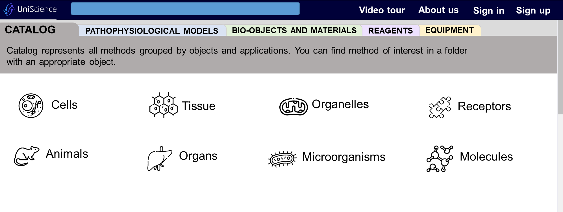
ВИЗУАЛИЗАЦИЯ КАТАЛОГА (папки с папками)
Вкладки для дальнейшего развития – новые каталоги
Object (уровень 1)
При раскрытии папок происходит углубление по уровням - Sub-object, Application, Methods

Slide 9

КАТАЛОГ ИЗ 2Х ВЕТОК
на развитие…
АДРЕСНАЯ КНИГА ИНО КЛАССИФИКАЦИИ
С ПОЯСНЕНИЯМИ
Method groped by type of technic
Physical and Physicochemical methods
Chromatography and similar technics
Electrophoretic methods

Slide 10

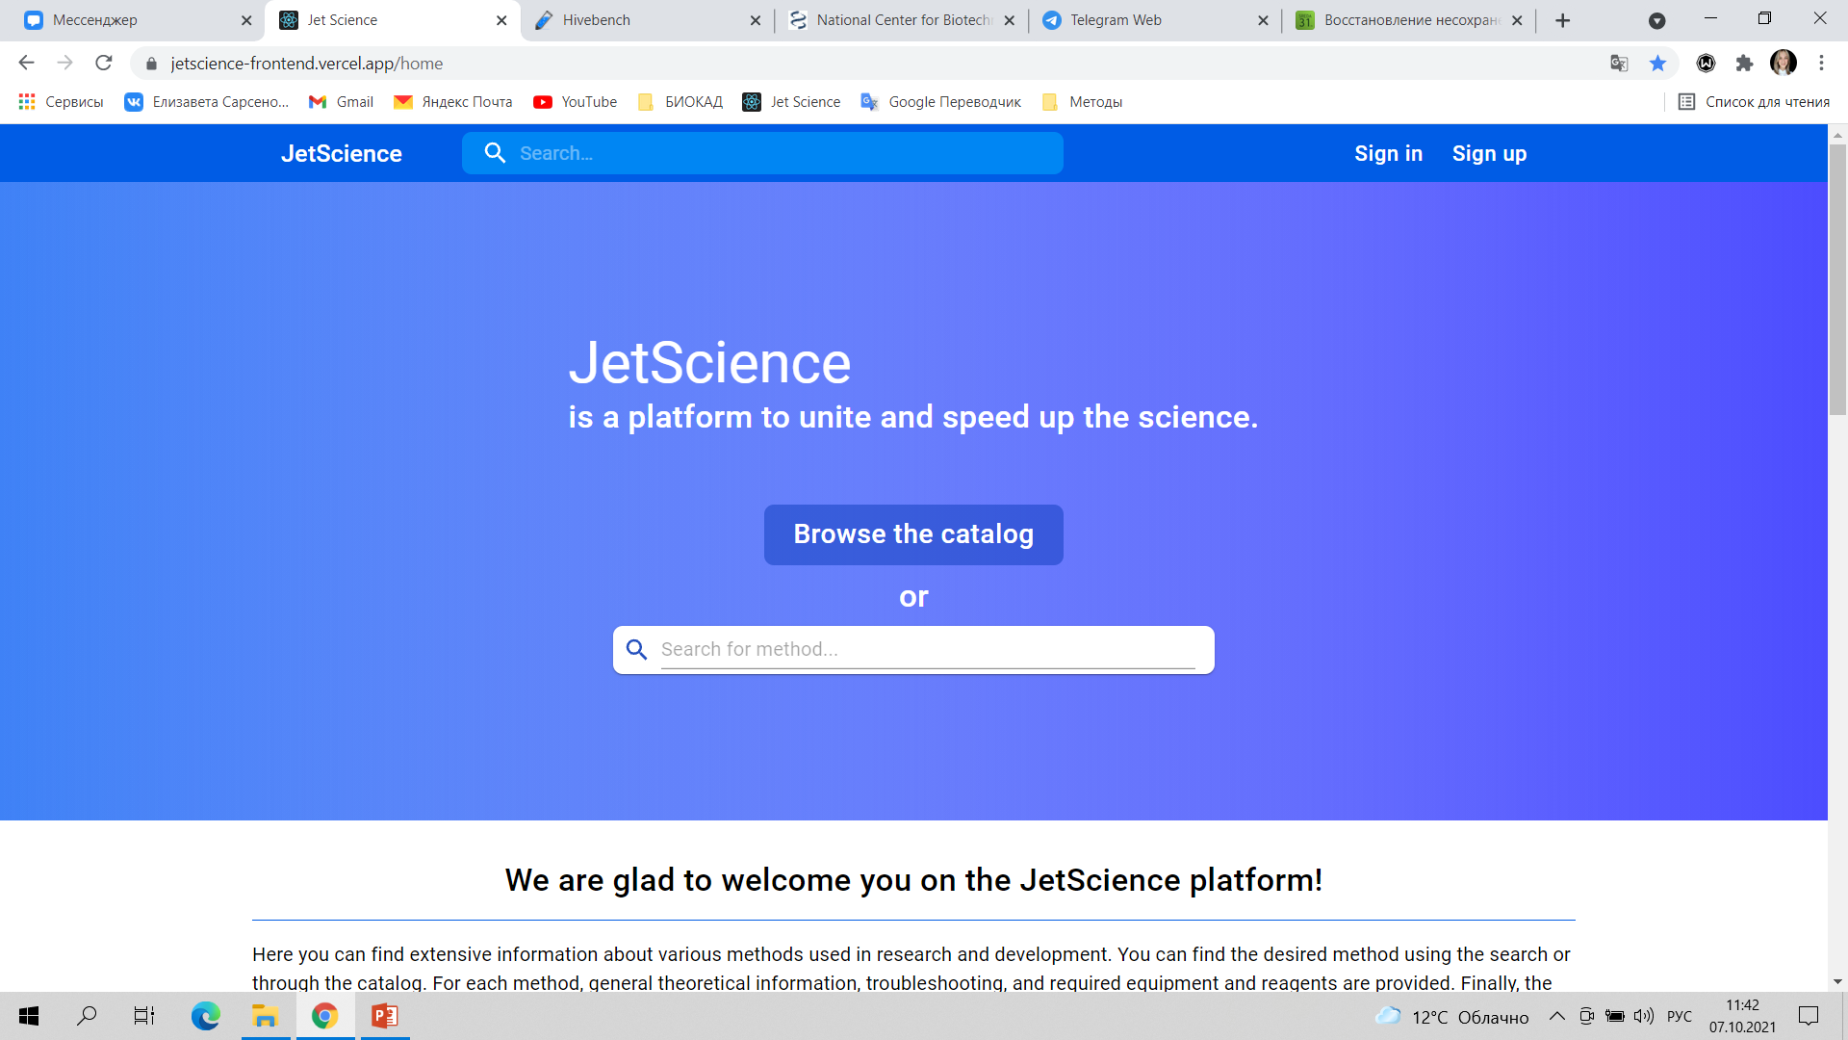
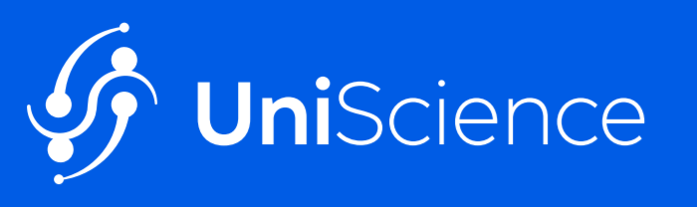









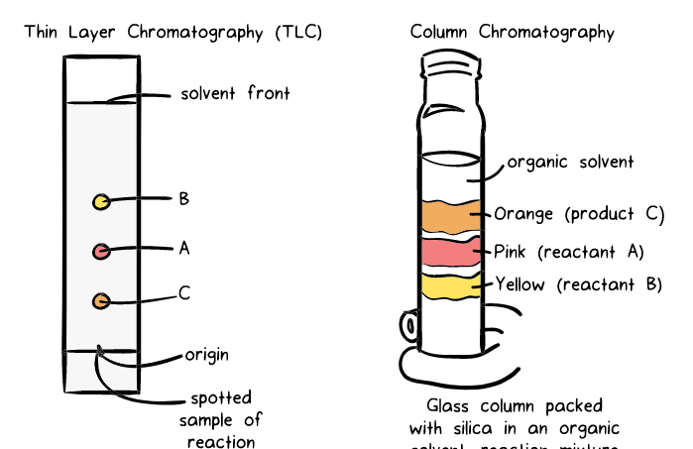
UNIScience
Chromatography
About us
Chromatography
Video tour
About us
Video tour
Video tour
About us
About us
Sign in
Sign in
Sign up
Sign up
Chromatography
Sign in
Sign up
METHODS (145)
CHROMATOGRAPHY
Chromatography is an analytical technique commonly used for separating a mixture of chemical substances into its individual components, so that the individual components can be thoroughly analyzed.
Physical and Physicochemical methods
There are many types of chromatography e.g., liquid chromatography, gas chromatography, ion-exchange chromatography, affinity chromatography, but all of these employ the same basic principles.
Chromatography is a separation technique that every organic chemist and biochemist is familiar with. I, myself, being an organic chemist, have routinely carried out chromatographic separations of a variety of mixture of compounds in the lab. In fact, I was leafing through my research slides and came across a pictorial representation of an actual chromatographic separation that I had carried out in the lab. I guess that picture would be a good starting point for this tutorial!
Let me first explain what I was trying to do here. I had two reactants ‘A’ and ‘B’. I let them react with each other, under certain reaction conditions, to form a product ‘C’. After the reaction was complete, I ended up with a reaction mixture that contained unreacted A, unreacted B and my desired product C. Now my task was to separate out A, B and C to isolate and analyze pure product C.
First, as shown in the left hand side panel, I ran a thin layer chromatography (TLC) plate. This is basically a rectangular piece of glass plate, coated with a thin layer of silica. I applied a spot of the reaction mixture just above the base of the plate (denoted with a solid line), and placed the plate in a in a jar that contained an appropriate organic solvent (in this case, 1:1 volume by volume mixture of hexane:ethyl acetate was used), with just enough volume to dip the lower edge of the plate.
Type of …..:
…..
……

Slide 11
СТРУКТУРА УЧЕБНИКА
Physical and Physicochemical methods
Chromatography and similar technics
Electrophoretic methods
SDS PAGE
Isoelectric focusing
Native PAGE
2D-PAGE
Gel Electrophoresis of Nucleic Acids
Blotting techniques
Western Blotting
Far-Western Blotting
Dot-Blotting
Southern Blotting
Immunochemical methods
Western Blotting
Far-Western Blotting
Dot-Blotting
Flow Cytometry
ELISA
PCR techniques
Real-Time PCR
Quantitative Real-Time PCR
- Type (уровень 1) = Глава
 |  | Textbook (Type of technique)
N | Methods (уровень 4) | Type (уровень 1) | Sub-Type (уровень 2) | Group (уровень 3)
1 | SDS-PAGE | Physical and Physicochemical methods | Chromatography and similar technics | Electrophoretic methods
2 | Native PAGE | Physical and Physicochemical methods | Chromatography and similar technics | Electrophoretic methods
3 | Isoelectric focusing | Physical and Physicochemical methods | Chromatography and similar technics | Electrophoretic methods
4 | 2D-PAGE | Physical and Physicochemical methods | Chromatography and similar technics | Electrophoretic methods
5 | Gel electrophoresis of nucleic acids | Physical and Physicochemical methods | Chromatography and similar technics | Electrophoretic methods
6 | Capillary electrophoresis | Physical and Physicochemical methods | Chromatography and similar technics | Electrophoretic methods
7 | Western blotting | Blotting techniques | - | -
 |  | Immunochemical methods | - | -
8 | Far-Western blotting | Blotting techniques | - | -
 |  | Immunochemical methods
9 | Dot Blotting | Blotting techniques | - | -
 |  | Immunochemical methods | - | -
10 | Flow cytometry | Immunochemical methods | - | -
11 | ELISA | Immunochemical methods | - | -
12 | Southern blotting | Blotting techniques | - | -
13 | Real-Time PCR | PCR Techniques | - | -
14 | Quantitative real time PCR | PCR Techniques | - | -
- Sub-Type (уровень 2) = Раздел
- Group (уровень 3)
- Methods
- Type (уровень 1) = Глава
- Methods
- Type (уровень 1) = Глава
- Methods)
- Type (уровень 1) = Глава
- Methods (уровень 4)

Slide 12
СХЕМА УЧЕБНИКА
By type
Type
(уровень 1)
Physical and Physicochemical methods
Blotting techniques
Immunochemical methods
PCR Techniques
….
Sub-type
(уровень 2)
Chromatography and similar technics
…..
Group
(уровень 3)
…..
Electrophoretic methods
Methods
Isoelectric focusing
2D-PAGE
Capillary electrophoresis
Western Blotting
Dot Blotting
…
Western Blotting
Dot Blotting
ELISA
Real time PCR
Quantitative real time PCR
…..
SDS-PAGE
Native PAGE
Gel electrophoresis of nucleic acids
…
Far-Western Blotting
Southern Blotting
Far-Western Blotting
Flow Cytometry
…
Лежат в учебнике в двух местах: Blotting techniques и Immunochemical methods

Slide 13
ВИЗУАЛИЗАЦИЯ УЧЕБНИКА (иерархическое оглавление)
Chromatography
Chromatography
Video tour
About us
Video tour
Video tour
About us
About us
About us
About us
Sign in
Sign in
Sign in
Sign in
Sign up
Sign up
Sign up
Sign up
Sign in
Sign up
TEXTBOOK
+
Textbook is your quid through different types of techniques.
Table of contents
Physical and Physicochemical methods
Electrochemical methods
Electrophoretic methods
SDS PAGE
Isoelectric focusing
Native PAGE
2D-PAGE
Gel Electrophoresis of Nucleic Acids
Blotting techniques
Western Blotting
Far-Western Blotting
Dot-Blotting
Southern Blotting
Immunochemical methods
Western Blotting
Far-Western Blotting
Визуализация схемы по запросу
Уровни – разделы учебника

Slide 14
КОНЦЕПЦИЯ 5-И ПАРАМЕТРОВ МЕТОДА
Name
Alternative name
Object
Поиск 1
Sub-Object
Catalog (Object-Application)
Object (уровень 1) | Sub-Object (уровень 2) | Application (уровень 3) | Filter
Application
Sub-Application
Поиск 2
(учебник)
Type
Textbook (Type of technique)
Type (уровень 1) | Sub-Type (уровень 2) | Group (уровень 3)
Sub-Type
Group
На развитие – для классификации по сфере деятельности (biotechnology / omics technologies / genetics и т.д.)
Tag

Slide 15

Две отдельные ветки поиска
About us
Каталог (Catalog)
Учебник (Textbook)
Chromatography
Chromatography
Video tour
About us
Video tour
About us
About us
Sign in
Sign in
Sign up
Sign up
Chromatography
Sign in
Sign up
METHODS (145)
CHROMATOGRAPHY
Sort by
name
✓
popularity
Filters
Object:
Sub-Object:
Application:
Sub-Application:
cells
animals
✓
proteins and peptides
analytical
….
tissue
organs
small molecules
preparative
….
organelles
microorganisms
✓
amino acids
receptors
✓
molecules
Ion-exchange High-performance liquid chromatography of amino acids
High-performance liquid chromatography (HPLC), formerly referred to as high-pressure liquid chromatography, is a technique in analytical chemistry used to separate, identify, and quantify each component in a mixture. Ion exchange chromatography is based on the association of charged groups in a liquid that passes over a solid support or ion exchange resin. Amino acids at pHs below their isoelectric point are positively charged and will bind to a cation exchange resin.
Type of …..:
…..
……
Filters:
Fast protein liquid chromatography
Fast protein liquid chromatography (FPLC), is a form of liquid chromatography that is often used to analyze or purify mixtures of proteins. As in other forms of chromatography, separation is possible because the different components of a mixture have different affinities for two materials, a moving fluid (the mobile phase) and a porous solid (the stationary phase).
Type of …..:
…..
……
Filters:
Immobilized metal affinity chromatography
Immobilized metal affinity chromatography (IMAC) is the most widely used method to purify the proteins according to their affinity to specific metal ions, which was first introduced by Porath (1989). This involves the use of phosphate affinity metals which are chelated on resin or beads and packed in a column.

Slide 16
Поиск и фильтры 07.12.2021

